Slide 1
2-26-2025 remaining issues

Slide 2
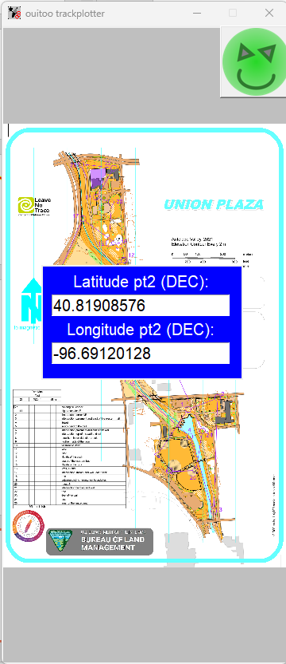
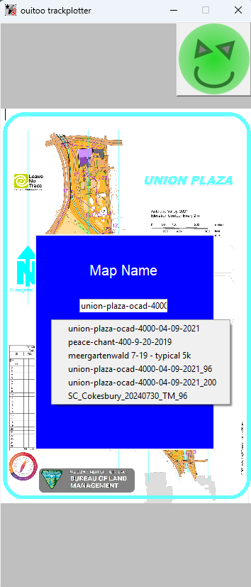
2-26-2025
5
Scale placement (Xpos, Ypos, width, height, font) parameters to the window diagonal
Make return button bg transparent

Slide 3
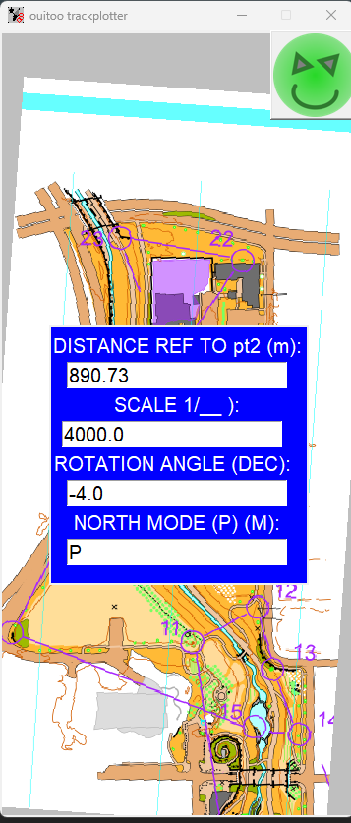

2-26-2025
7
Keep scale and display a text “Scale is: scale at DPI dpi” as a label with transparent bg
“Current Scale: scale” with a delay and disappearing ?

Slide 4
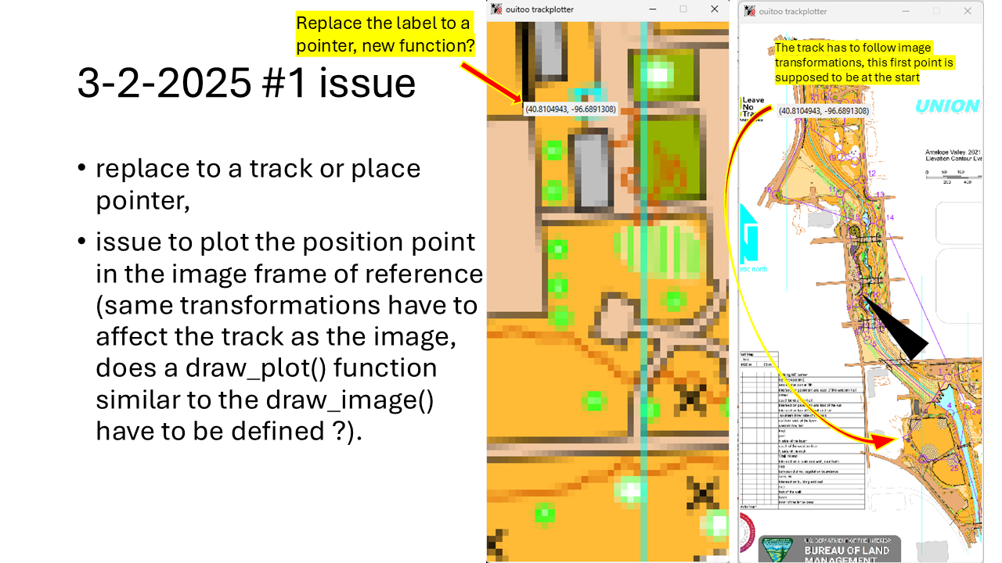
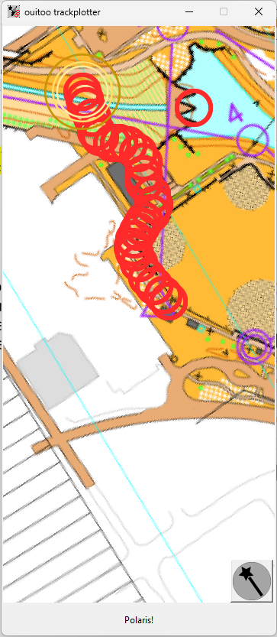
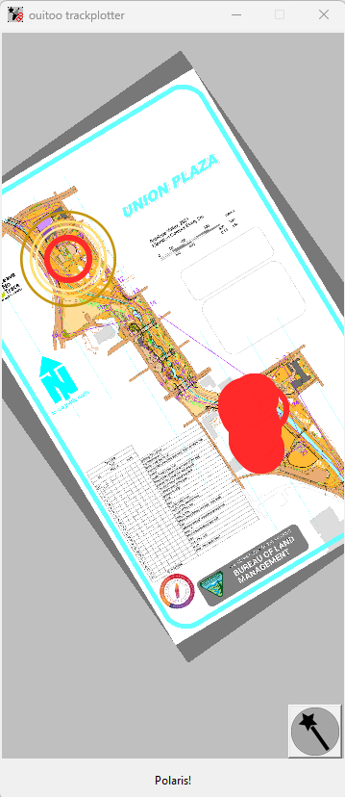
BEFORE
ACTUAL
A pointer is used to plot positions on the map
The track updates and follows image transformation
(2-26-2025 #1 issue fixed: no more pointer after exiting user inputs section)
3-2-2025 #1 issue fixed in user input Polaris Mode AND rotation angle set to 0.0

Slide 5
3-15-2025 issues

Slide 6
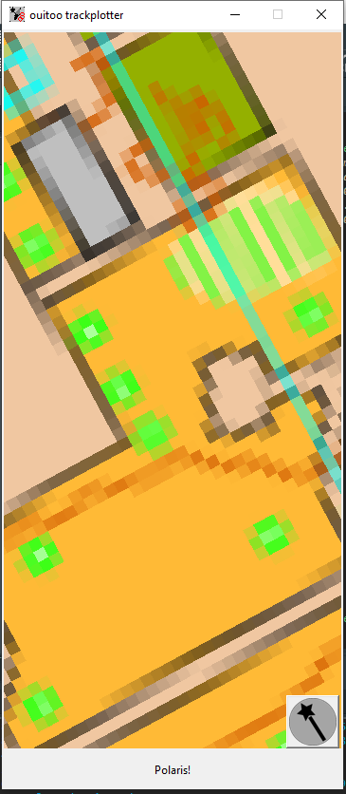
3-15-2025
1
Ctrl-Alt-Double click, binding to close the app
The binding on north icon should also kill the Thread started in GPS_to_screen() scope
Ctrl-Alt-Double click, binding to close the app
Scope of TrackPlot() ?

Slide 7
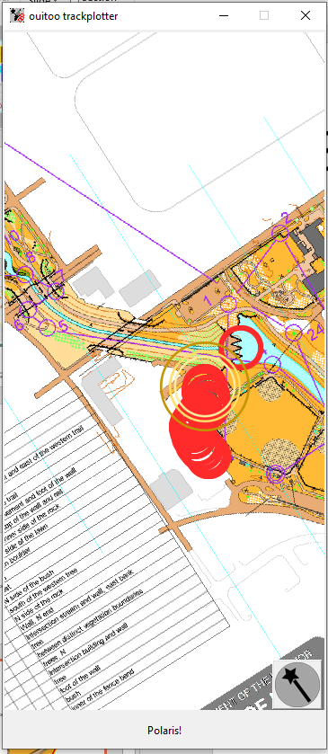
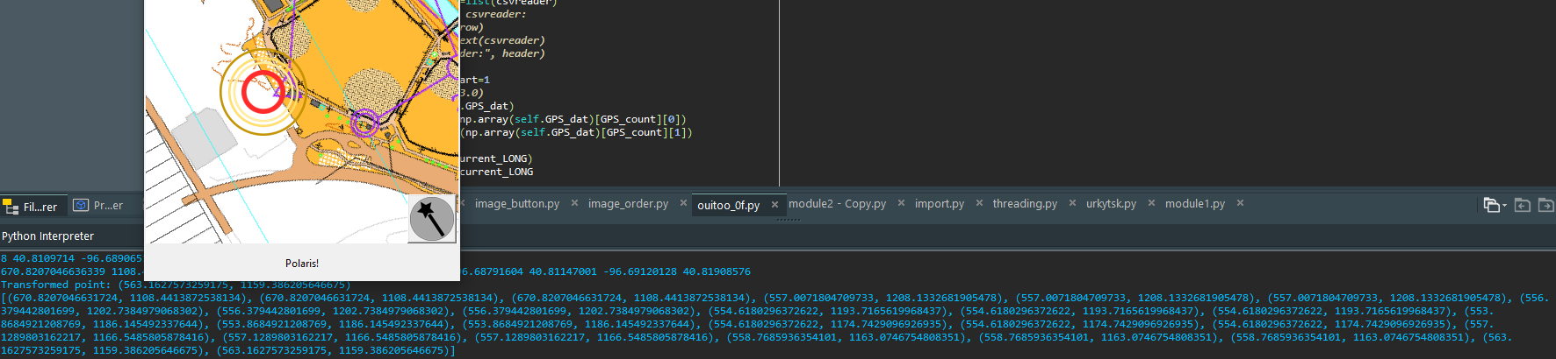
3-15-2025
2
The binding on north icon should also kill the Thread started in GPS_to_screen() scope
Ctrl-Alt-Double click, binding to close the app
Scope of TrackPlot() ?

Slide 8
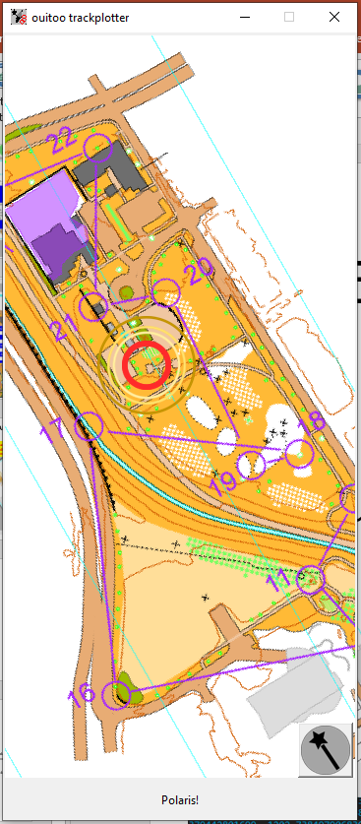
3-15-2025
3
The binding on north icon should also kill the Thread started in GPS_to_screen() scope
Ctrl-Alt-Double click, binding to close the app
Scope of TrackPlot() ?

Slide 9
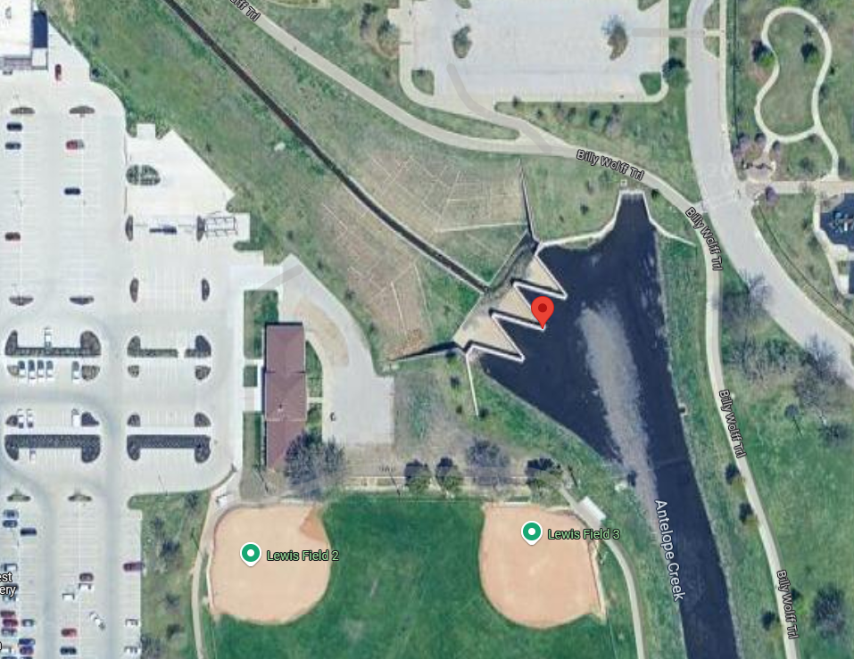
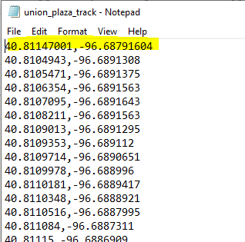
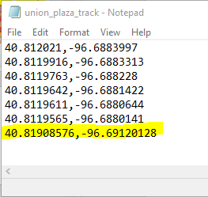
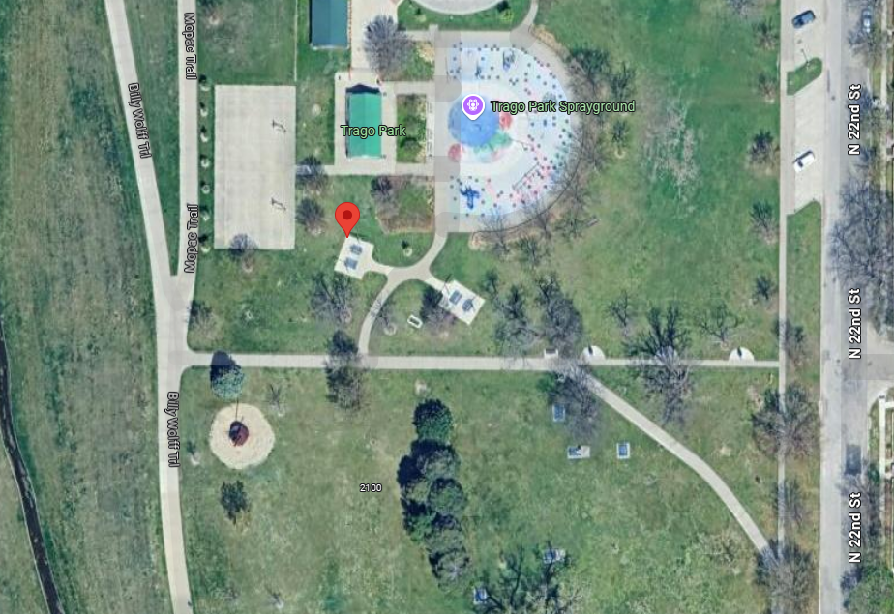
3-15-2025
3
The binding on north icon should also kill the Thread started in GPS_to_screen() scope
Ctrl-Alt-Double click, binding to close the app
Scope of TrackPlot() ?

Slide 10
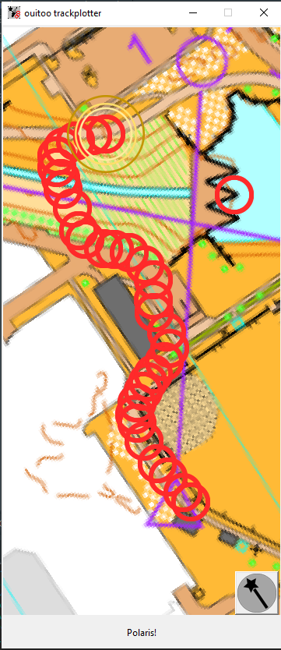
3-15-2025
3
The binding on north icon should also kill the Thread started in GPS_to_screen() scope
Ctrl-Alt-Double click, binding to close the app
Scope of TrackPlot() ?

